Slide 1

Topic 2
Supply and Demand I:
How Markets Work
© 2002 by Nelson, a division of Thomson Canada Limited

Slide 2
In this chapter you will…
Learn the nature of a competitive market.
Examine what determines the demand for a good in a competitive market.
Examine what determines the supply of a good in a competitive market.
See how supply and demand together set the price of a good and the quantity sold.
Consider the key role of prices in allocating scarce resources.

Slide 3
THE MARKET FORCES OF SUPPLY AND DEMAND
Supply and Demand are the two words that economists use most often.
Supply and Demand are the forces that make market economies work!
Modern microeconomics is about supply, demand, and market equilibrium.

Slide 4
MARKETS AND COMPETITION
The terms supply and demand refer to the behaviour of people. . .
. . .as they interact with one another in markets.
A market is a group of buyers and sellers of a particular good or service.
Buyers determine demand...
Sellers determine supply…

Slide 5
DEMAND
If you demand something, then you
1. Want it,
2. Can afford it, and
3. Have made a definite plan to buy it.
Wants are the unlimited desires or wishes people have for goods and services. Demand reflects a decision about which wants to satisfy.
Quantity Demanded refers to the amount (quantity) of a good that buyers are willing to purchase at alternative prices for a given period.

Slide 6
Determinants of Demand
What factors determine how much ice-cream you will buy?
What factors determine how much you will really purchase?
Product’s Own Price
Consumer Income
Prices of Related Goods
Preferences/Expectations
Tastes

Slide 7
1) Price
Law of Demand
The law of demand states that, other things equal, the quantity demanded of a good falls when the price of the good rises.

Slide 8
2) Income
As income increases the demand for a normal good will increase.
As income increases the demand for an inferior good will decrease.

Slide 9
3) Prices of Related Goods
Prices of Related Goods
When a fall in the price of one good reduces the demand for another good, the two goods are called substitutes.
When a fall in the price of one good increases the demand for another good, the two goods are called complements.

Slide 10
4) Others
Tastes
Expectations

Slide 11
The Demand Schedule and the Demand Curve
The demand schedule is a table that shows the relationship between the price of the good and the quantity demanded.
The demand curve is a graph of the relationship between the price of a good and the quantity demanded.
Ceteris Paribus: “Other thing being equal”

Slide 12
Table 4-1: Catherine’s Demand Schedule
Price of Ice-cream Cone ($)
Quantity of cones Demanded
0.00
12
0.50
10
1.00
8
1.50
6
2.00
4
2.50
2
3.00
0

Slide 13
Figure 4-1: Catherine’s Demand Curve
Price of Ice-Cream Cone
$3.00
2.50
2.00
1.50
1.00
0.50
0
2
4
6
8
10
12
Quantity of Ice-Cream Cones

Slide 14
Market Demand Schedule
Market demand is the sum of all individual demands at each possible price.
Graphically, individual demand curves are summed horizontally to obtain the market demand curve.
Assume the ice cream market has two buyers as follows…

Slide 15
Table 4-2: Market demand as the Sum of Individual Demands
Price of Ice-cream Cone ($)
Catherine
Nicholas
Market
0.00
12
7
19
+
=
0.50
10
6
16
1.00
8
5
13
1.50
6
4
10
2.00
4
3
7
2.50
2
2
4
3.00
0
1
1

Slide 16
Figure 4-3: Shifts in the Demand Curve
Price of Ice-Cream Cone
Increase in demand
Decrease in demand
D₂
D₁
D₃
Quantity of Ice-Cream Cones

Slide 17
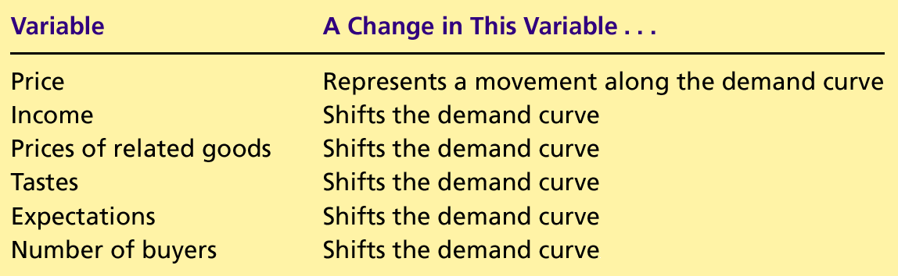
Table 4-3: The Determinants of Quantity Demanded

Slide 18
Shifts in the Demand Curve versus Movements Along the Demand Curve

Slide 19
Figure 4-4 a): A Shifts in the Demand Curve
Price of Cigarettes, per Pack.
A policy to discourage smoking shifts the demand curve to the left.
B
A
$2.00
D₁
D₂
0
10
20
Number of Cigarettes Smoked per Day

Slide 20
Figure 4-4 b): A Movement Along the Demand Curve
Price of Cigarettes, per Pack.
C
A tax that raises the price of cigarettes results in a movements along the demand curve.
$4.00
A
$2.00
D₁
0
12
20
Number of Cigarettes Smoked per Day

Slide 21
SUPPLY
Quantity Supplied refers to the amount (quantity) of a good that sellers are willing to make available for sale at alternative prices for a given period.

Slide 22
Determinants of Supply
What factors determine how much ice cream you are willing to offer or produce?
Product’s Own Price
Input prices
Technology
Expectations
Number of sellers

Slide 23
1) Price
Law of Supply
The law of supply states that, other things equal, the quantity supplied of a good rises when the price of the good rises.

Slide 24
The Supply Schedule and the Supply Curve
The supply schedule is a table that shows the relationship between the price of the good and the quantity supplied.
The supply curve is a graph of the relationship between the price of a good and the quantity supplied.
Ceteris Paribus: “Other thing being equal”

Slide 25
Table 4-4: Ben’s Supply Schedule
Price of Ice-cream Cone ($)
Quantity of cones Supplied
0.00
0
0.50
0
1.00
1
1.50
2
2.00
3
2.50
4
3.00
5

Slide 26
Figure 4-5: Ben’s Supply Curve
Price of Ice-Cream Cone
$3.00
2.50
2.00
1.50
1.00
0.50
0
1
2
3
4
5
6
8
10
12
Quantity of Ice-Cream Cones

Slide 27
Market Supply Schedule
Market supply is the sum of all individual supplies at each possible price.
Graphically, individual supply curves are summed horizontally to obtain the market demand curve.
Assume the ice cream market has two suppliers as follows…

Slide 28
Table 4-5: Market supply as the Sum of Individual Supplies
Price of Ice-cream Cone ($)
Ben
Nicholas
Market
0.00
0
0
0
+
=
0.50
0
0
0
1.00
1
0
1
1.50
2
2
4
2.00
3
4
7
2.50
4
6
10
3.00
5
8
13

Slide 29
Figure 4-7: Shifts in the Supply Curve
Price of Ice-Cream Cone
S₃
S₁
S₂
Decrease in supply
Increase in supply
Quantity of Ice-Cream Cones

Slide 30
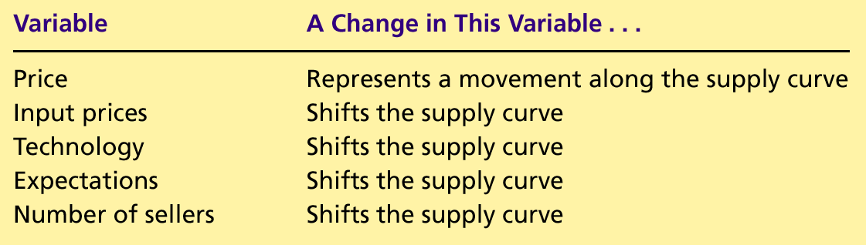
Table 4-6: The Determinants of Quantity Supplied

Slide 31
SUPPLY AND DEMAND TOGETHER
Equilibrium refers to a situation in which the price has reached the level where quantity supplied equals quantity demanded.

Slide 32
Equilibrium
Equilibrium Price
The price that balances quantity supplied and quantity demanded.
On a graph, it is the price at which the supply and demand curves intersect.
Equilibrium Quantity
The quantity supplied and the quantity demanded at the equilibrium price.
On a graph it is the quantity at which the supply and demand curves intersect.

Slide 33
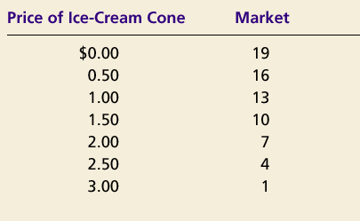
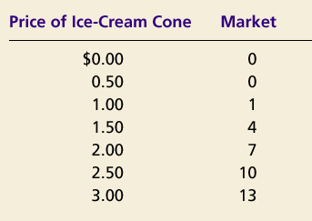
Equilibrium
Demand Schedule
Supply Schedule
At $2.00, the quantity demanded is equal to the quantity supplied!

Slide 34
Figure 4-8: The Equilibrium of Supply and Demand
Price of Ice-Cream Cone
Supply
Equilibrium price
Equilibrium
$2.00
Demand
Equilibrium quantity
0
1
2
3
4
5
6
7
8
9
10
11
Quantity of Ice-Cream Cones

Slide 35
Equilibrium
Surplus
When price > equilibrium price, then quantity supplied > quantity demanded.
There is excess supply or a surplus.
Suppliers will lower the price to increase sales, thereby moving toward equilibrium.
Shortage
When price < equilibrium price, then quantity demanded > the quantity supplied.
There is excess demand or a shortage.
Suppliers will raise the price due to too many buyers chasing too few goods, thereby moving toward equilibrium.

Slide 36
Figure 4-9 a): Excess Supply
Price of Ice-Cream Cone
Surplus
Supply
$2.50
$2.00
Demand
0
1
2
3
4
5
6
7
8
9
10
11
Quantity of Ice-Cream Cones
Quantity Demanded
Quantity Supplied

Slide 37
Figure 4-9 b): Excess Demand
Price of Ice-Cream Cone
Supply
$2.00
$1.50
Shortage
Demand
0
1
2
3
4
5
6
7
8
9
10
11
Quantity of Ice-Cream Cone
Quantity Supplied
Quantity Demanded

Slide 38
Three Steps To Analyzing Changes in Equilibrium
Decide whether the event shifts the supply or demand curve (or both).
Decide whether the curve(s) shift(s) to the left or to the right.
Use the supply-and-demand diagram to see how the shift affects equilibrium price and quantity.
Example: Hot weather

Slide 39
Figure 4-10: How an Increase Demand Affects the Equilibrium
Price of Ice-Cream Cone
1. Hot weather increases the demand for ice cream…
Supply
$2.50
New equilibrium
$2.00
Initial equilibrium
D₂
2. … resulting in a higher price …
D₁
0
1
2
3
4
5
6
7
10
11
Quantity of Ice-Cream Cone
3. … and a higher quantity sold.

Slide 40
Figure 4-11: How a Decrease Supply Affects the Equilibrium
Price of Ice-Cream Cone
S₂
1. An earthquake reduces the supply of ice cream…
S₁
$2.50
New equilibrium
$2.00
Initial equilibrium
2. … resulting in a higher price …
Demand
0
1
2
3
4
7
10
11
Quantity of Ice-Cream Cones
3. … and a lower quantity sold.

Slide 41
Figure 4-12 a): A Shift in Both Supply and Demand
Price of Ice-Cream Cone
Large increase in demand
S₂
New equilibrium
S₁
P₂
Small decrease in supply
P₁
Initial equilibrium
D₂
D₁
0
Q₁
Q₂
Quantity of Ice-Cream Cone

Slide 42
Figure 4-12 b): A Shift in Both Supply and Demand
Price of Ice-Cream Cone
Small increase in demand
New equilibrium
S₂
S₁
P₂
Large decrease in supply
P₁
Initial equilibrium
D₂
D₁
0
Q₂
Q₁
Quantity of Ice-Cream Cone

Slide 43
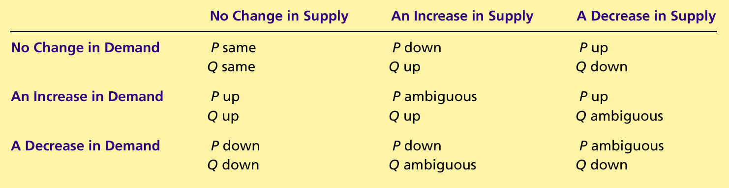
Table 4-8: What Happens to Price and Quantity when Supply or Demand Shifts

Slide 44
Concluding Remarks…
Market economies harness the forces of supply and demand. . .
Supply and Demand together determine the prices of the economy’s different goods and services. . .
Prices in turn are the signals that guide the allocation of resources.

Slide 45
Summary
Economists use the model of supply and demand to analyze competitive markets.
In a competitive market, there are many buyers and sellers, each of whom has little or no influence on the market price.

Slide 46
Summary
The demand curve shows how the quantity of a good depends upon the price.
According to the law of demand, as the price of a good falls, the quantity demanded rises. Therefore, the demand curve slopes downward.
In addition to price, other determinants of how much consumers want to buy include income, the prices of complements and substitutes, tastes, expectations, and the number of buyers.
If one of these factors changes, the demand curve shifts.

Slide 47
Summary
The supply curve shows how the quantity of a good supplied depends upon the price.
According to the law of supply, as the price of a good rises, the quantity supplied rises. Therefore, the supply curve slopes upward.
In addition to price, other determinants of how much producers want to sell include input prices, technology, expectations, and the number of sellers.
If one of these factors changes, the supply curve shifts.

Slide 48
Summary
Market equilibrium is determined by the intersection of the supply and demand curves.
At the equilibrium price, the quantity demanded equals the quantity supplied.
The behavior of buyers and sellers naturally drives markets toward their equilibrium.

Slide 49
The End

